Slide 1
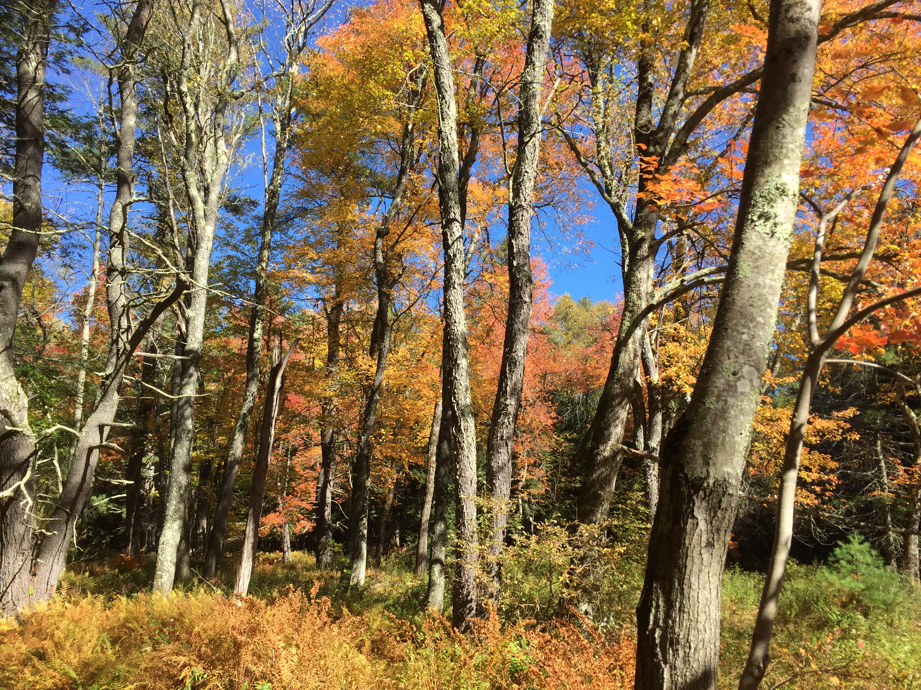
Understanding plant phenology in a warming world
Examining microclimatic effects

Slide 2
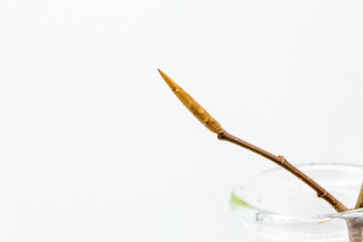
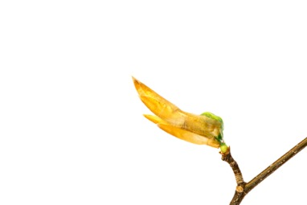
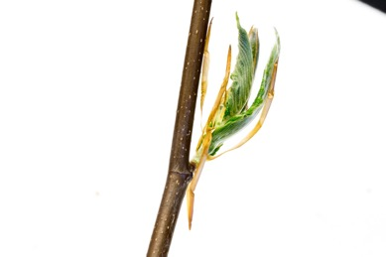
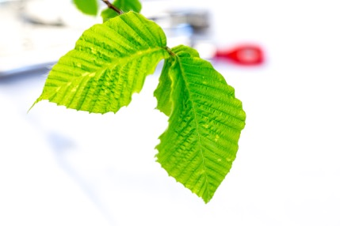
American Beech: Fagus sylvatica
DORMANT BUD
BUDBURST
LEAFOUT

Slide 3
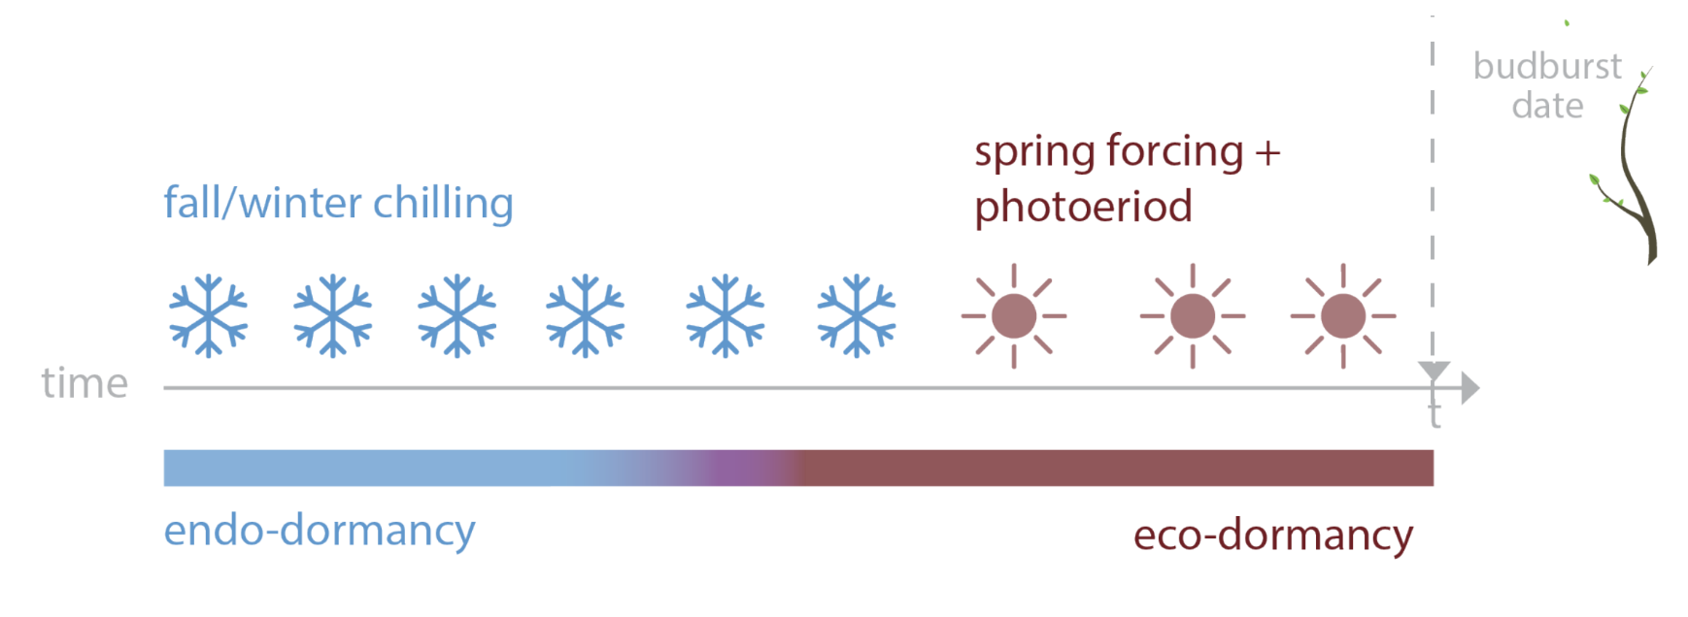
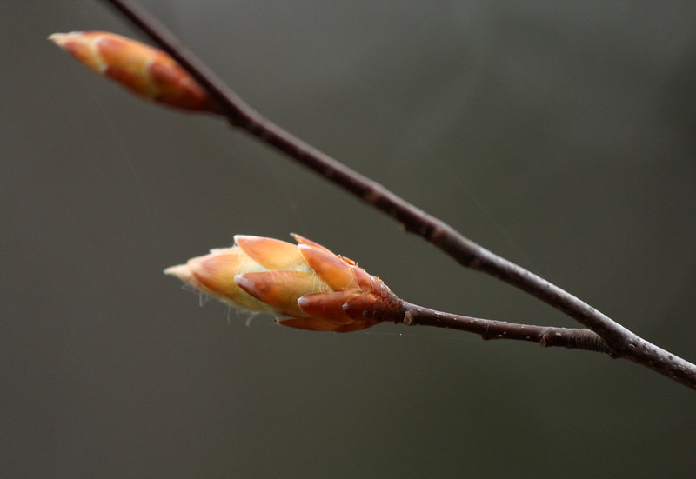
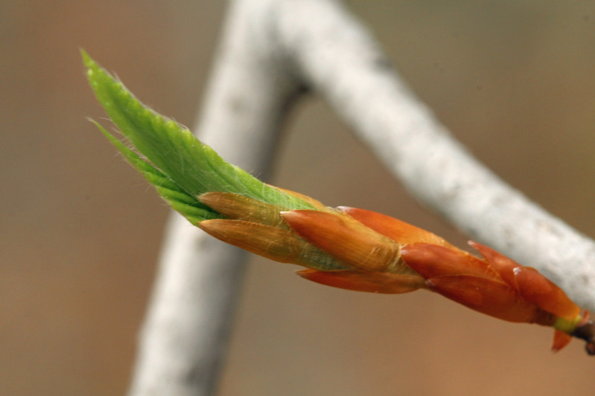
PHENOLOGY USES MULTIPLE CUES
spring warming + daylength
Ettinger, Chamberlain, et al, Nature Climate Change

Slide 4
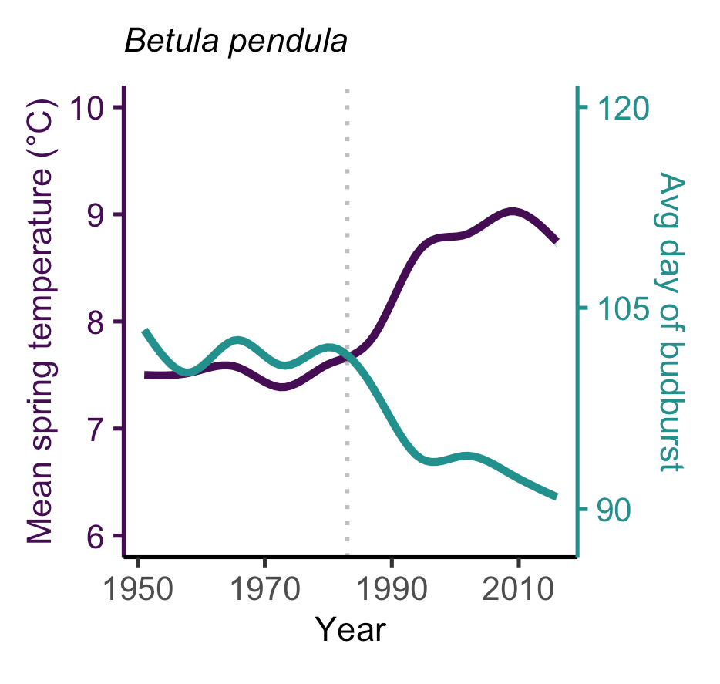
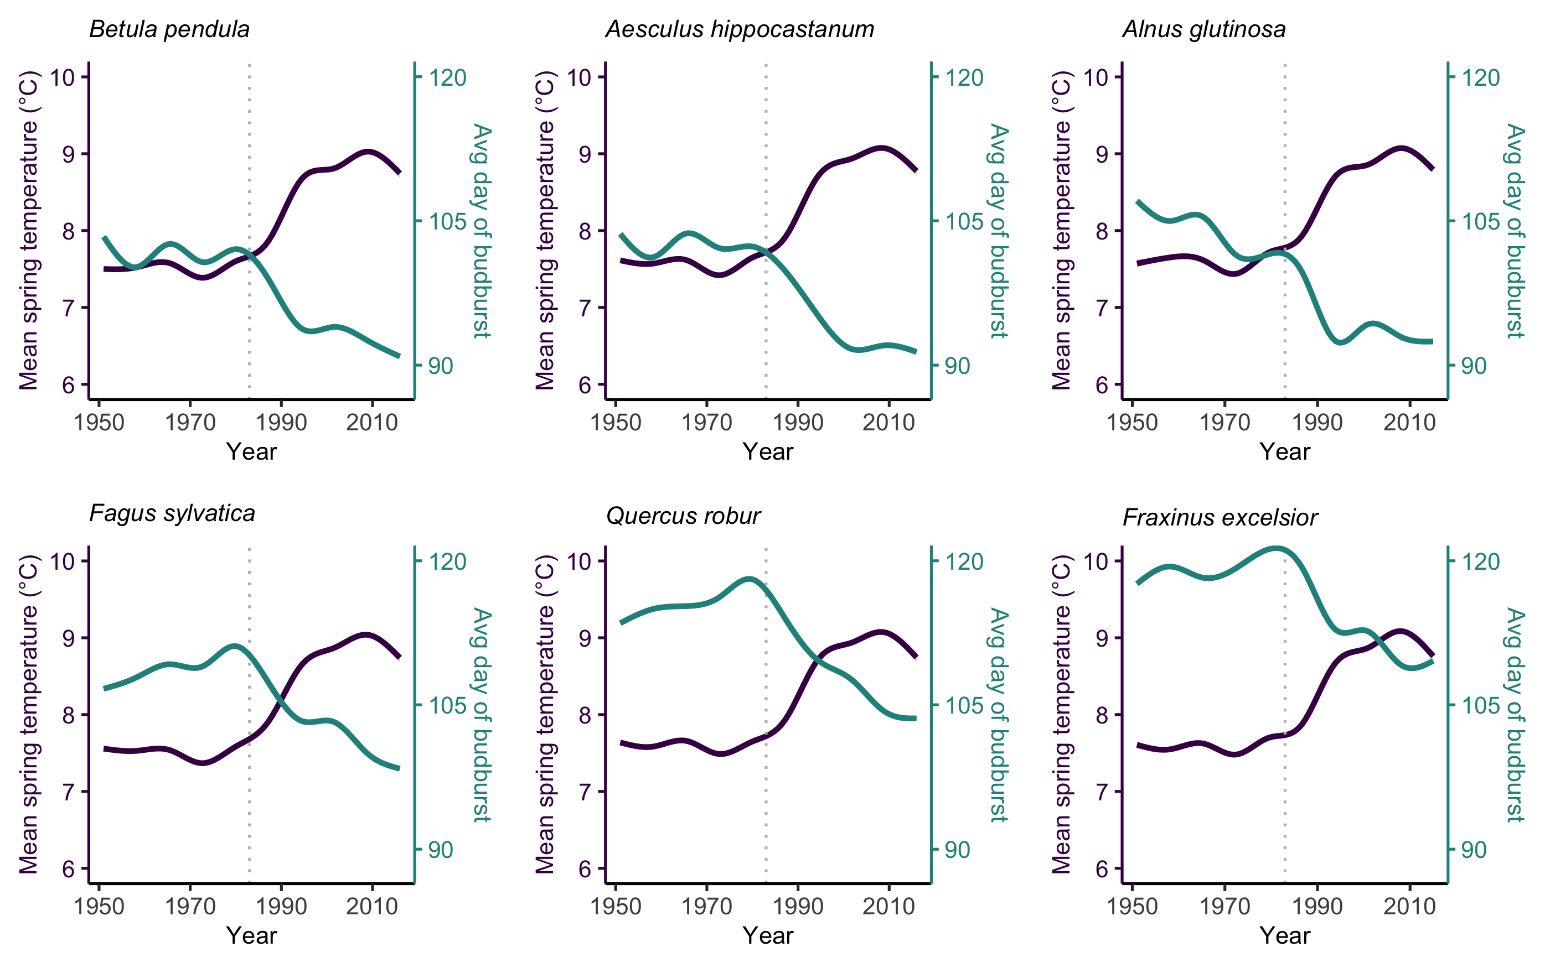
PHENOLOGY IS ADVANCING
Chamberlain et al, New Phytologist

Slide 5
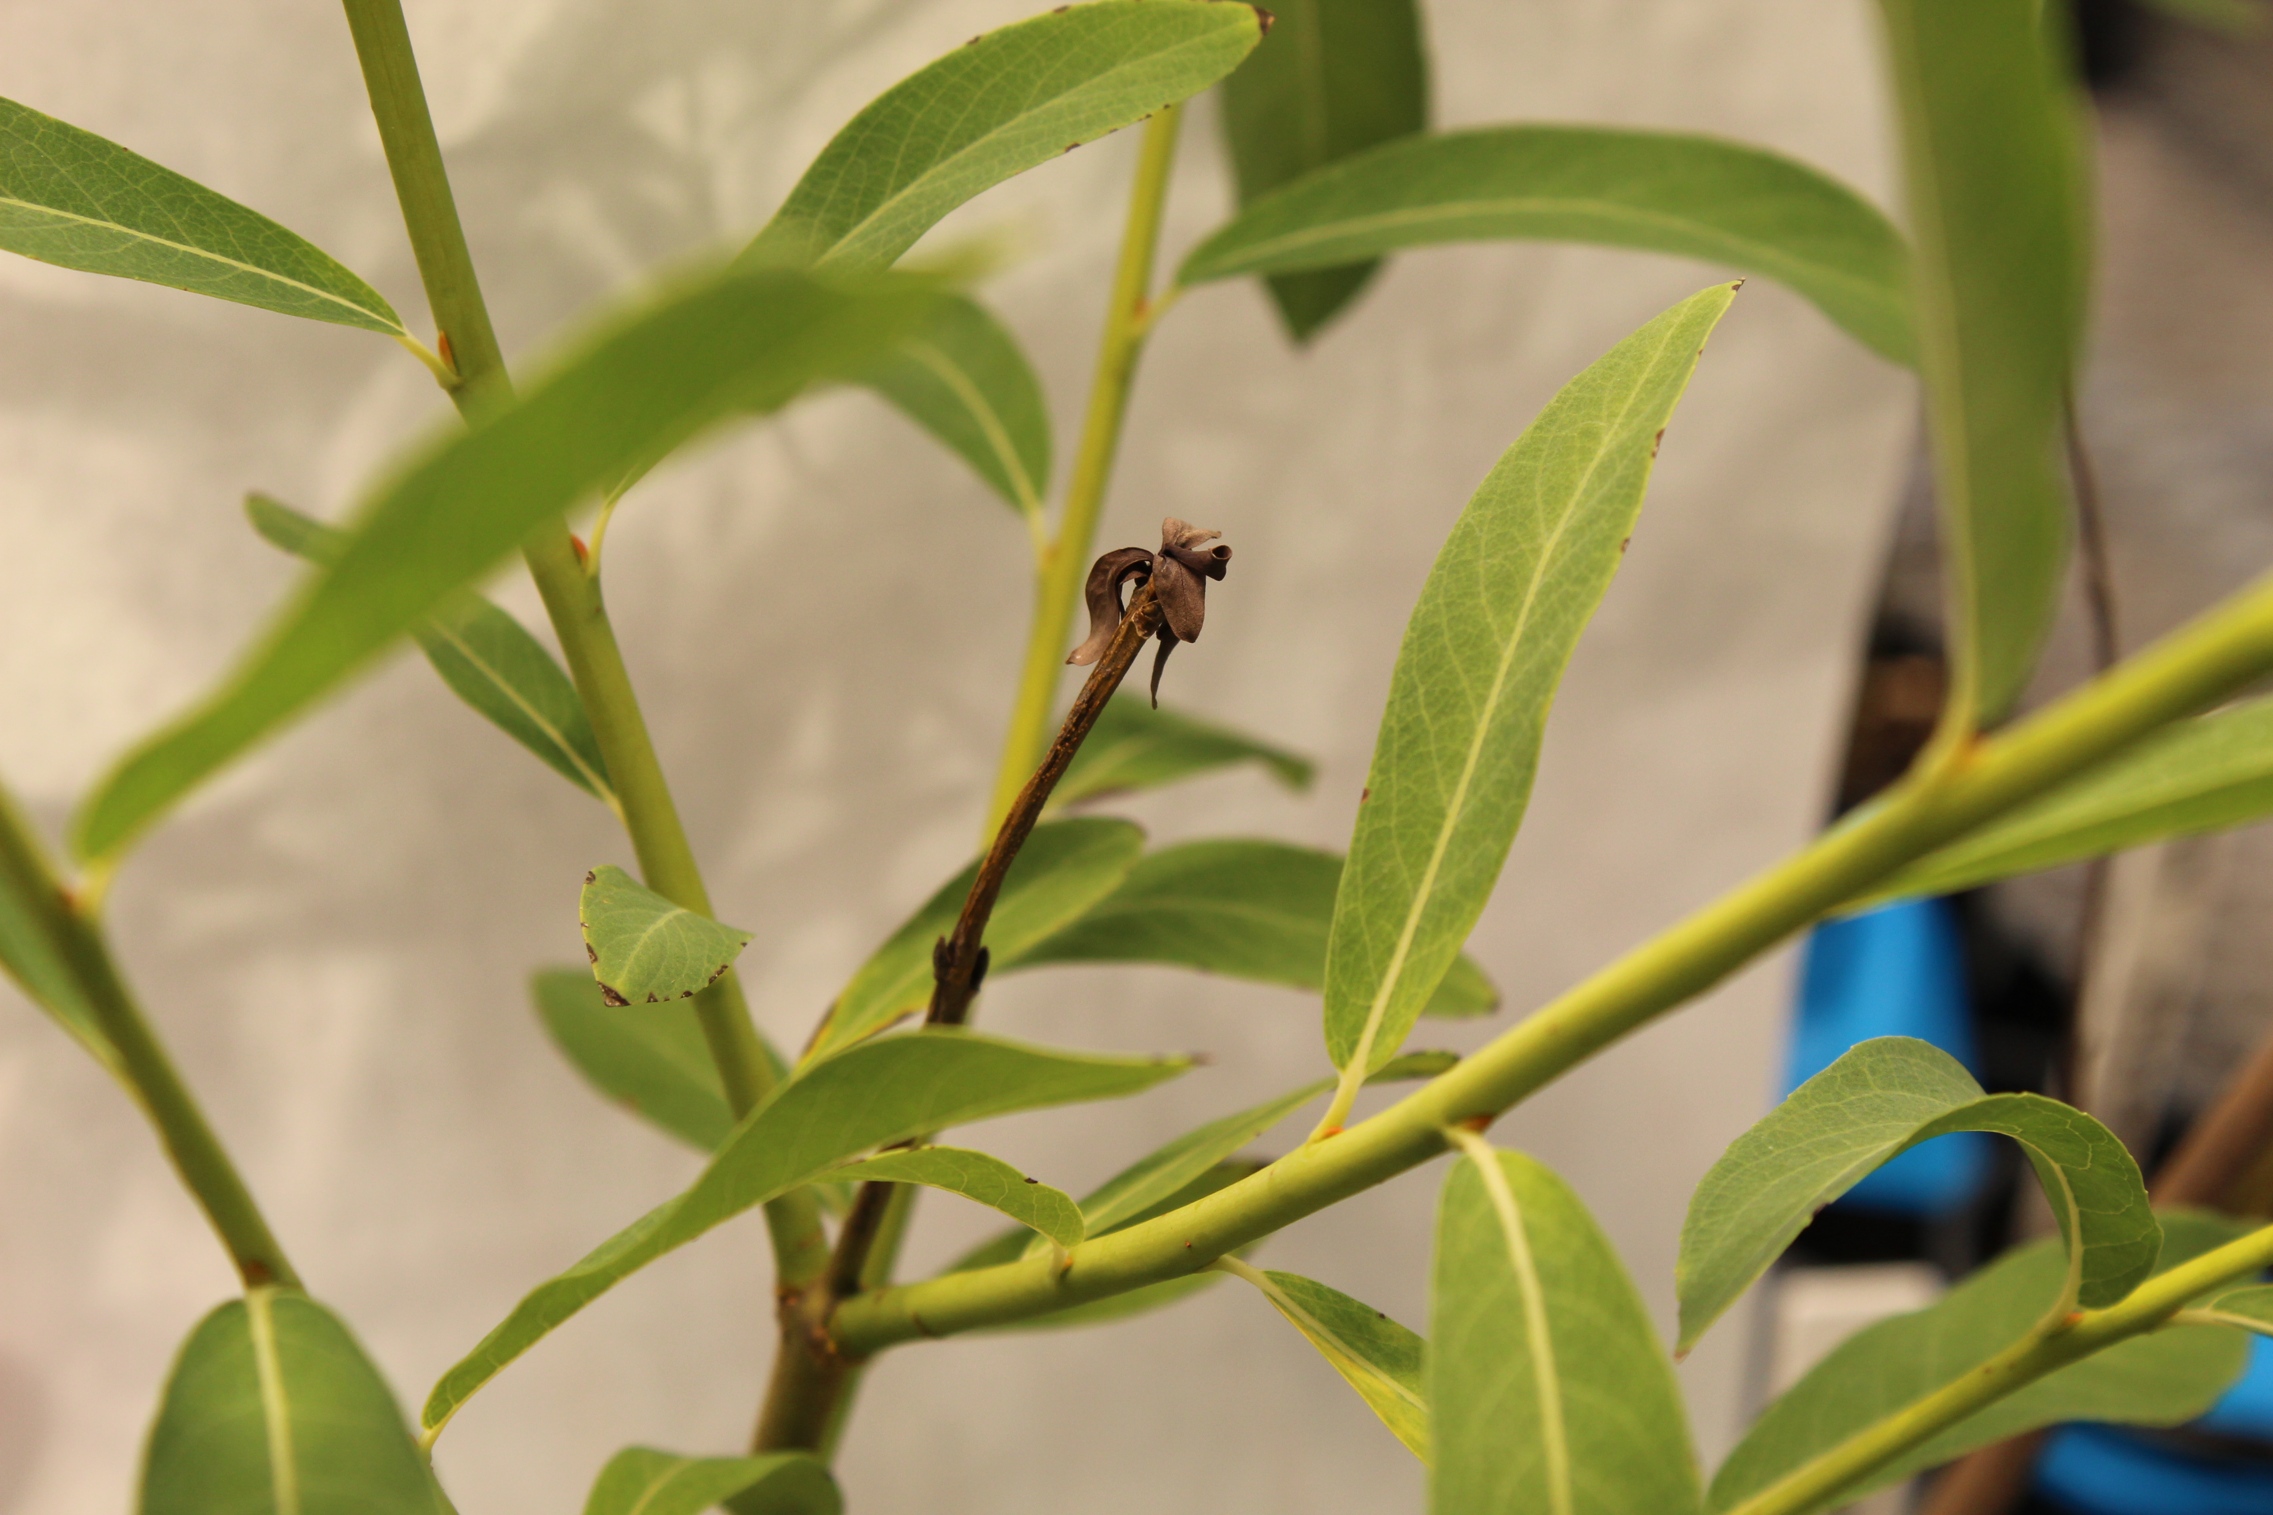
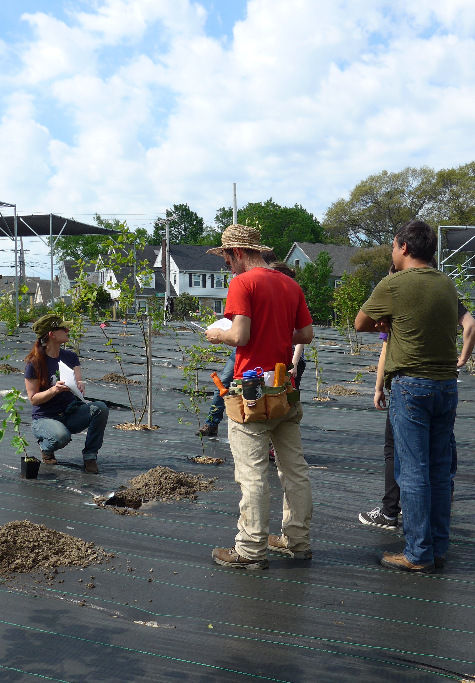
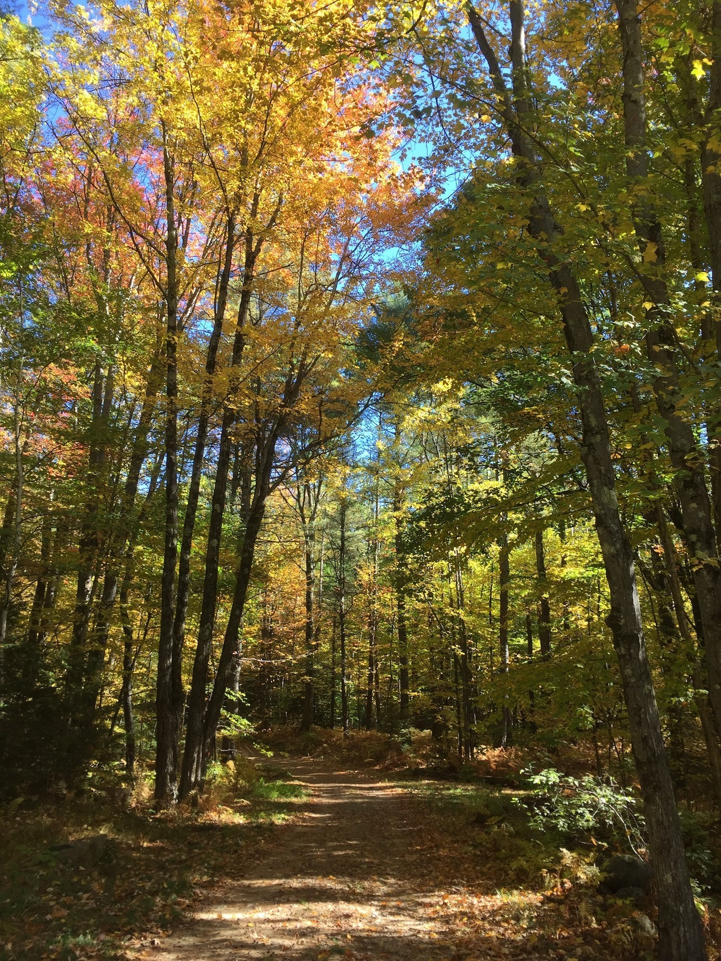
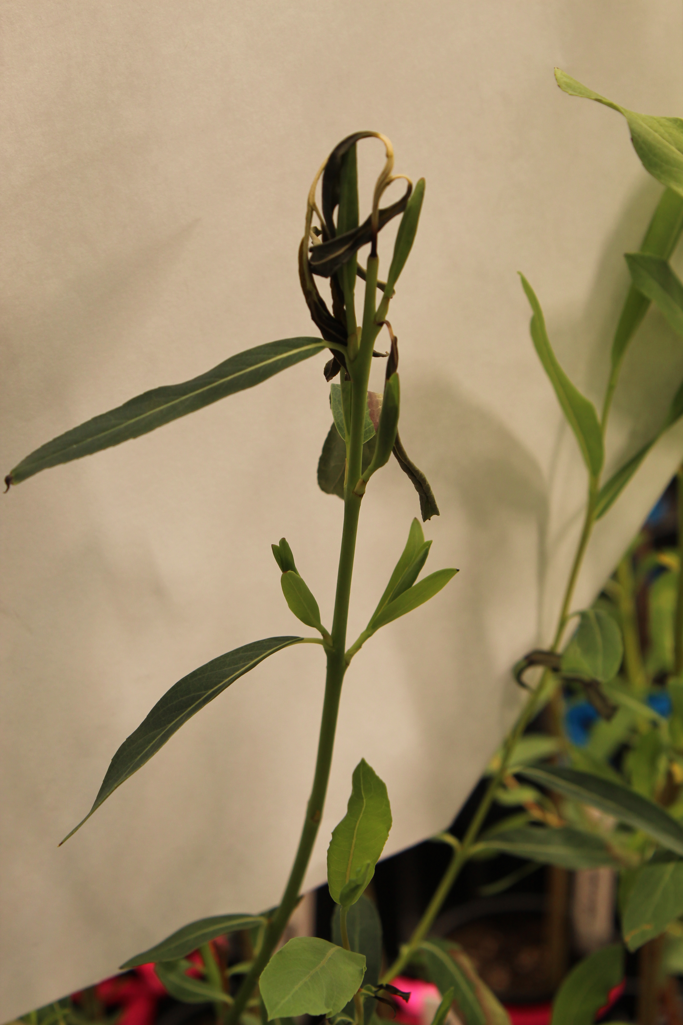
WHY IS PLANT PHENOLOGY SO IMPORTANT?
Spring Freeze Risk
Drought Risk
Growth Rate
Carbon Sinks

Slide 6
Growing Degree Days (GDDs)
Definition: accumulation of spring warming temperatures
If temperature is greater than 0℃, then you add up the temperatures
Temp (℃) – 0 ℃ = X
E.g., Temperature is 5 ℃ for Day 1, 7 ℃ for Day 2 and -2 ℃ for Day 3
Day 1: 5 – 0 = 5
Day 2: 7 – 0 = 7
Day 3: -2 - 0 = 0 (doesn’t count)
So by Day 3, 12 GDDs (5+7) have been accumulated.

Slide 7
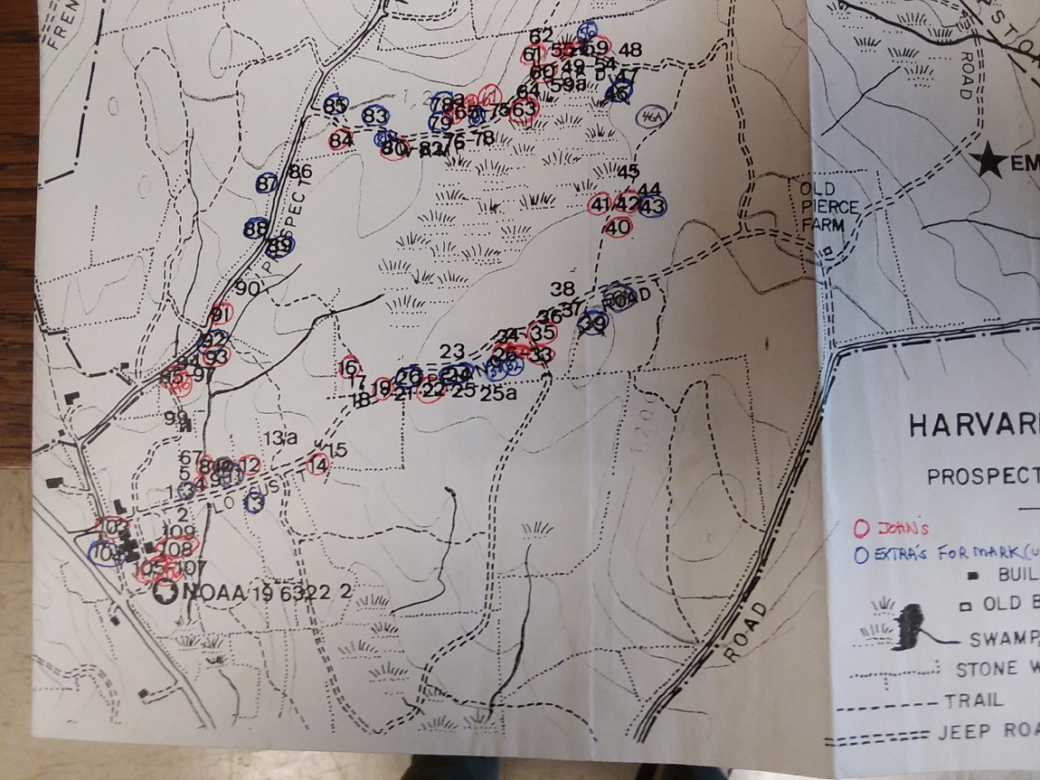

Slide 8
Budburst to leafout
Harvard Forest
Arnold Arboretum

Slide 9
ARBORETUM MICROCLIMATES?
Model estimate of change in degree days to budburst
Model estimate of change in degree days to budburst

Slide 10
HARVARD FOREST MICROCLIMATES?
Model estimate of change in degree days to budburst
Model estimate of change in degree days to budburst

Slide 11
How similar are the GDDs to budburst across sites?

Slide 12
Breakdown of weather data
ARBORETUM
HARVARD FOREST

Slide 13
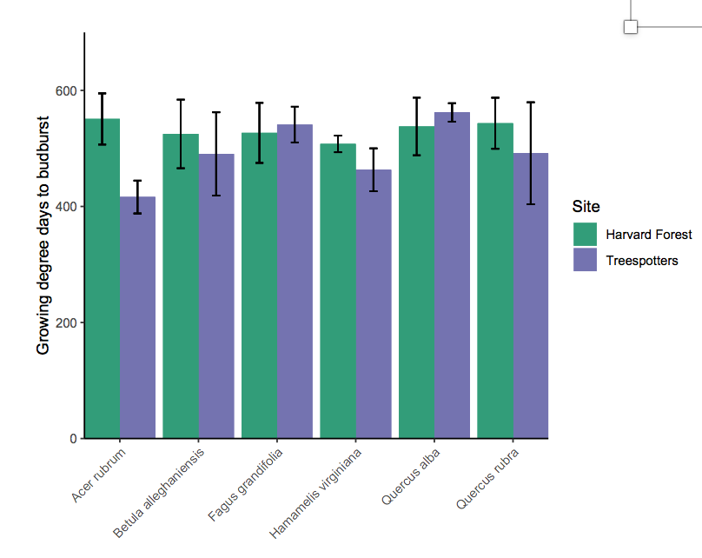
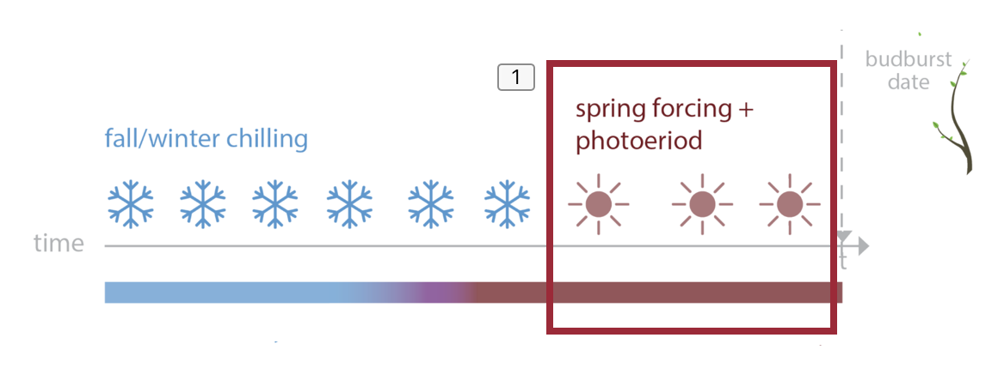
QUICK CONCLUSIONS
MICROCLIMATES EXIST! But more so at the Arboretum than the forest
GDDS ARE NOT ALWAYS CONSISTENT ACROSS SPECIES
And can vary across sites
PHENOLOGY IS FINICKY. More work to be done!

Slide 14
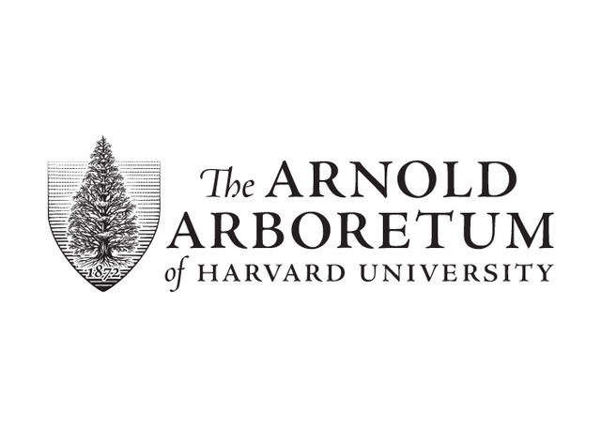



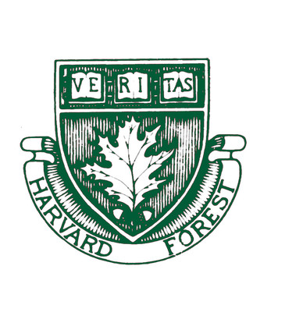
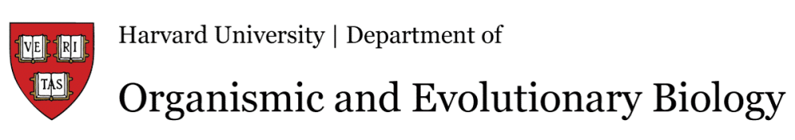



THE TEMPORAL ECOLOGY LAB
Lizzie Wolkovich, PhD
Dan Buonaiuto
Ignacio Morales-Castilla, PhD
Aileen Ettinger, PhD
Deirdre Loughnan
Darwin Sodhi
ARNOLD ARBORETUM - TREE SPOTTERS
Suz Mrozak
Danny Schissler
Kate Stonefoot
Pam Thompson
Our Citizen Scientists!!
COMMITTEE MEMBERS
Paul Moorcroft, PhD
Neil Pederson, PhD
COLLABORATORS AND SPECIAL THANKS
Iñaki Garcia de Cortazar-Atauri, PhD
Ben Cook, PhD
Kea Woodruff
Faye Rosin
Alice Linder
Dan Flynn
Alissandra Ayala
John O’Keefe, PhD
Audrey Barker Plotkin
THE HOLBROOK LAB
Noel Michele Holbrook, PhD
Fulton Rockwell, PhD
Jess Gersony
Anju Manandhar
Meghan Blumstein
Morgan Furze, PhD
Zhe He

